Slide 1
Crowd Simulation
Zhicheng Chen

Slide 2
Introduction
Increasing proportion of people living in urban.
A crowd forms when a large amount of people gathers in a limited space.

Slide 3
Contribution
Agents form waiting lines and each agent orderly pass through simulated security checking spots one by one.
Agents move in and out of waiting line to move to the desired waiting line.
Agents walk in pair stay side by side while walking and waiting.
Statistically significant results from user study shows improvements.

Slide 4
Previous Work
Mirza Waqar[2] designed agents as ellipses that have a sense of the environment and plan their own path ahead of time to avoid agent collisions.
Julio Godoy [6] provided a dynamic agent base approach that allowed agents in a scene to have distinct goals and plan their own movements and collision avoidance ability.
Carmine [3] extended state-of-art predictive approaches with social awareness, prediction, and social collision avoidance to achieve the prediction in social path following behavior.

Slide 5
Observations of Video Records
Pair walking and lining up in pairs
Queue up behaviors.
People forming waiting lines
People switching from a long line to shorter one

Slide 6
Foundation architecture and Scenario
Recast and Detour:
Recast is a state-of-the-art navigation mesh construction toolset for games.
Detour is a spatial reasoning toolkit which accompanies with Recast to offer a simple static navigation mesh.

Slide 7
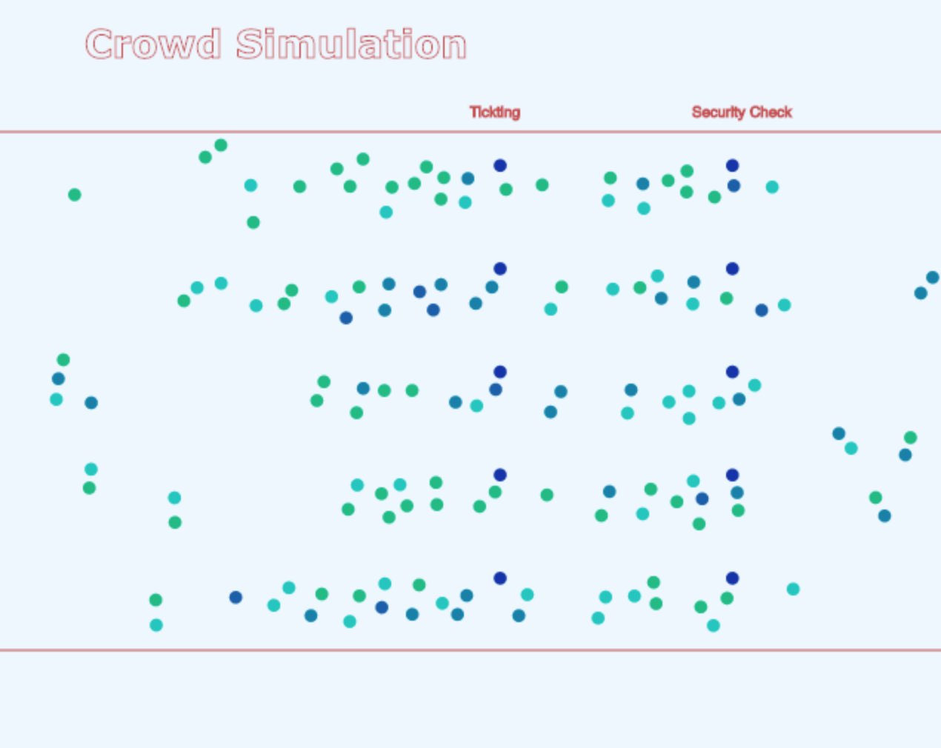
Foundation architecture and Scenario
Scenario:

Slide 8
Environment Implementation and Setup
Input Data Initialization
Environment Initialization

Slide 9
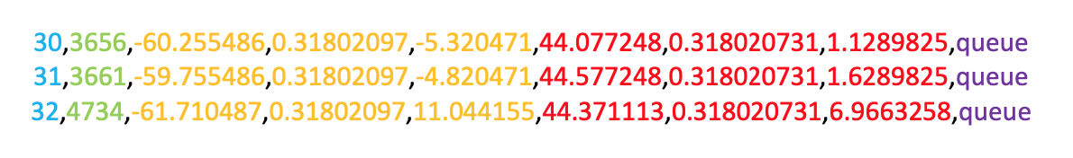
Environment Implementation and Setup
Input Data Initialization
Input file determines the basic scene information.
Agent id
Agent start time
Start position
End position
Behavior mode
Appearance Feature of Upcoming Agents

Slide 10
Environment Implementation and Setup
Environment Initialization
Gates initialization
Agent pair relationship initialization
Agent’s checking time initialization
Agent’s anxiety initialization
Agents pick gate

Slide 11
Agent Behavior Implementation
Pair walking behavior
Queue up behavior
Re-consider behavior

Slide 12
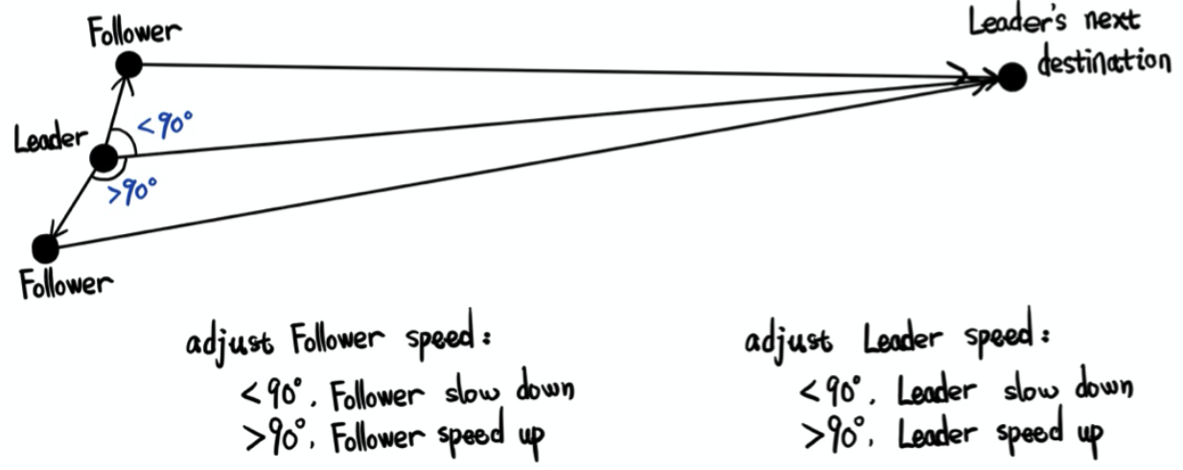
Agent Behavior Implementation
Pair walking behavior

Slide 13
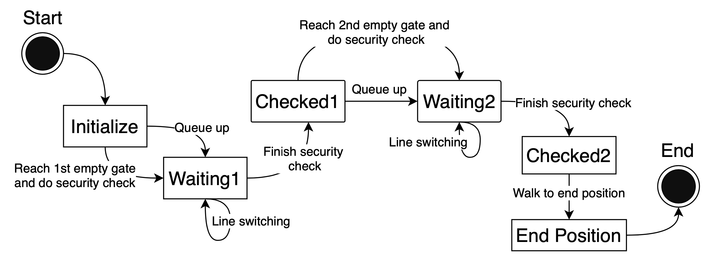
Agent Behavior Implementation
Queue up behavior

Slide 14
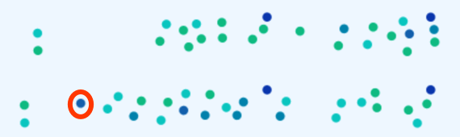
Agent Behavior Implementation
Re-consider behavior
Agents decide to change line when they have the maximum anxiety degree.
Anxiety update process:

Slide 15
Evaluation
Input data evaluation
Behavior evaluation
Mechanical turk survey

Slide 16
Evaluation
Input data evaluation
Input data follows the required pattern.
Agents’ id and enter time are list in ascending order.
Agents in pair relationship have close enter time and share close start and end coordinates.

Slide 17
Evaluation
Behavior evaluation
Based on observations of the simulation result, agents could achieved the required behaviors.

Slide 18
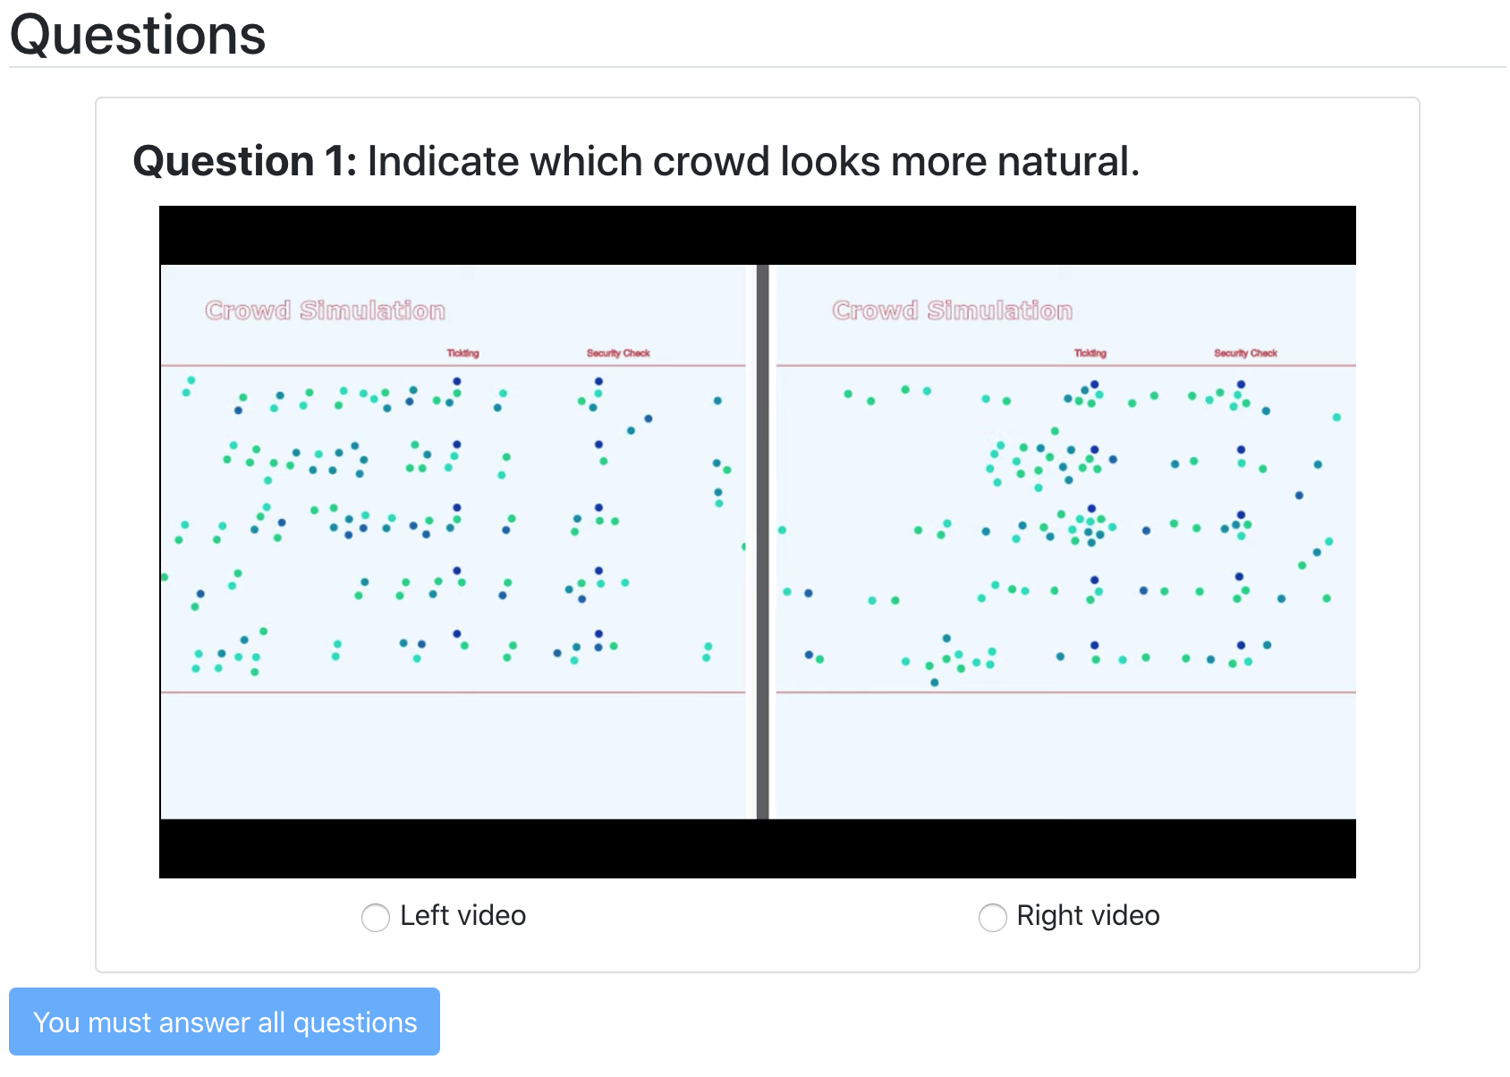
Evaluation
Mechanical turk survey

Slide 19
Evaluation
Mechanical turk survey
Survey | Improvements on the left | Improvements on the right
Left votes | 33 | 20
Right votes | 18 | 37
P-value | 0.0244 | 0.0166

Slide 20
Future work
Allow more than 2 agents to have pair relationship.
Allow agents to adjust their line up position based on the environment.

Slide 21
Thank you

